Slide 1



COFFEE
SHOP SALES
SAMUEL ORIJA

Slide 2


TABLE OF CONTENT
Problem Statement
KPI’s Requirement
Charts Requirement
Methods
Data Modelling
Challenges and Strategies Adopted
Recommendations
SAMUEL ORIJA

Slide 3
PROBLEM STATEMENT
The stakeholders intend to create a Coffee Sales Report Dashboard for a period of six months(January-June), 2023. So as to gain insight on the following requirements :
Total Sales Analysis
2. Total Orders Analysis
3. Total Quantity Sold Analysis

Slide 4
KPI’S REQUIREMENTS
Total Sales Analysis
Calculate the total sales for each respective month.
Determine the month-on-month increase or decrease in sales
Calculate the difference in sales between the selected month and the previous month
2. Total Orders Analysis :
Calculate the total number of orders for each respective month.
Determine the month-on-month increase or decrease in the number of orders.
Calculate the difference in the number of orders between the selected month and the previous month.
SAMUEL ORIJA

Slide 5
KPI’S REQUIREMENTS
3.Total Quantity Sold Analysis
Calculate the total quantity sold for each respective month.
Determine the month-on-month increase or decrease in the total quantity sold.
Calculate the difference in the total quantity sold between the selected month and the previous month
SAMUEL ORIJA

Slide 6

CHARTS REQUIREMENTS
1. Calendar Heat Map :
Implement a calendar heat map that dynamically adjusts based on the selected month from a slicer.
Each day on the calendar will be color-coded to represent sales volume, with darker shades indicating higher sales.
Implement tooltips to display detailed metrics (Sales, Orders, Quantity) when hovering over a specific day.
SAMUEL ORIJA

Slide 7
CHARTS REQUIREMENTS
2. Sales Analysis by Weekdays and Weekends:
Segment sales data into weeekdays and weekends to analyze performance variations
Provide insights into wether sales patterns differ significantly between weekdays and weekends.
3. Sales Analysis by Store Location:
Visualize sales data by different store locations.
Include momth-over-month(MoM) difference metrics based on the selected month in the slicer.
Highlight the MoM sales increase or decrease for each store location to identify trends.

Slide 8
METHODS
DATA MODELLING
DATA PROCESSING
A connection was created between the Transaction Table and the Date Table using the data model.
After thorough exploratory data analysis. Created a Date table(Custom table) which made it easier to extract and navigates through ‘date’. Using advance DAX ( Format, IF and Weeknum function), to curate the required columns.

Slide 9
CHALLENGES
In the visualization of the Sales Trend Over the Period, using the stacked column chart, the constant line indicating the ease of identification of sales above and below average, prevented the bars from displaying despite all efforts.
ADOPTED STRATEGIES
The refreshed button was used and the visuals deleted. It was then re-selected afresh and all required facts and dimensions carefully added.
SAMUEL ORIJA

Slide 10
RECOMMENDATION
The following recommendations are based on the monthly sales, orders, and quantity sold analysis, and are aimed at optimizing operations, increasing sales, and enhancing customer satisfaction:
Implementation of strategic marketing campaigns, by focusing on peak months(March, April and May).
Ensure adequate inventory management, stocking up on high-demand products, to withstand the increased sales and orders, mostly during peak months
Introduce promotional offers and discounts during off-peak months to sustain steady sales growth and customer retention.
SAMUEL ORIJA

Slide 11

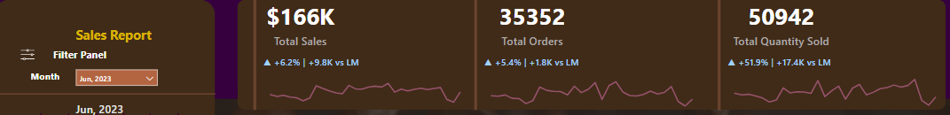
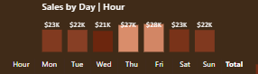
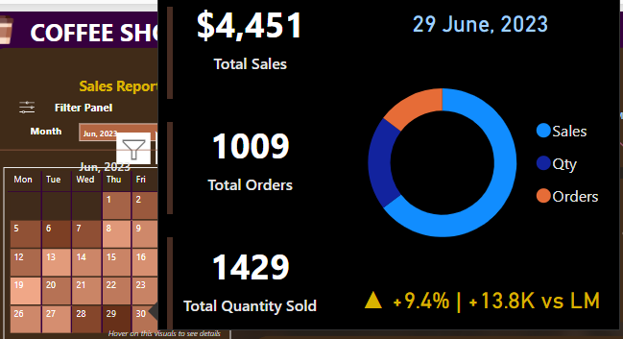
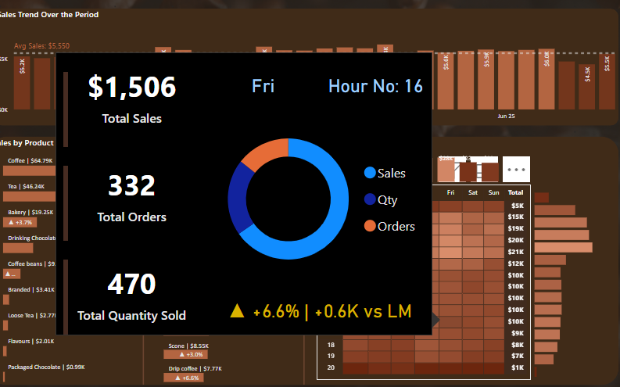
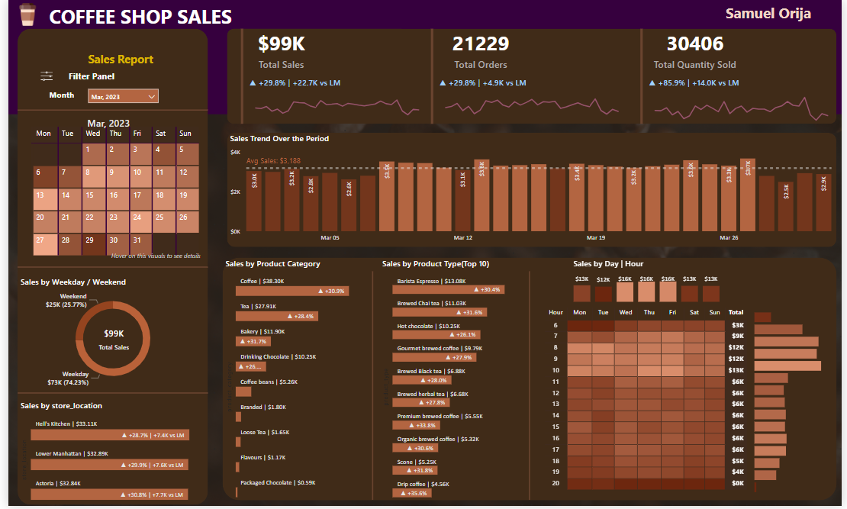
BY: SAMUEL ORIJA

Slide 12
THANK YOU
SAMUEL ORIJA

